Slide 1

Market Basket Analysis
By group 7:
P HARSHAVARDHAN (20012375)
JAHNAVI ENUGANTI (20018465)
KEERTHI CHINMAYEE (20018316)
BYREDDY ASLESHA REDDY (20018659)

Slide 2
Introduction
Market basket analysis explores the relationship between products by considering the co-occurrence of purchases in previous transactions.
Market basket analysis is a process that looks for relationships of objects that “go together” within the business context.
Market basket analysis is the analysis of any collection of items to identify affinities that can be exploited in some manner.
Market basket analysis is a process that looks for relationships among entities and objects that frequently appear together, such as the collection of items in a shopper’s cart.
Product placement - Identifying products that may often be purchased together and arranging the placement of those close by to encourage the purchaser to buy both items.

Slide 3
Introduction
That placement can be physical, such as in the arrangement of products on shelves in a brick and mortar location, or virtual, such as in a print catalog or on an e-commerce site.
Point-of-Sale—Companies may use the affinity grouping of multiple products as an indication that customers may be predisposed to buying certain sets of products at the same time.
This enables the presentation of items for cross-selling or may suggest that customers may be willing to buy more items when certain products are bundled together.
Customer retention—When customers contact a business to sever a relationship, a company representative may use market basket analysis to determine the right incentives to offer in order to retain the customer’s business.

Slide 4
Methodologies
Apriori Algorithm:
The Apriori algorithm is a popular data mining technique used to identify frequently occurring item sets in a dataset.
The algorithm is based on the principle that if an itemset is frequent, then all of its subsets must also be frequent.
By leveraging this observation, the algorithm is able to narrow down the search space and avoid searching through all possible item sets, which can be computationally expensive.

Slide 5
Methodologies
ECLAT Algorithm:
The ECLAT (Equivalence Class Clustering and Bottom-Up Lattice Traversal) algorithm is a popular algorithm in data mining for finding frequent item sets in a dataset.
Like the Apriori algorithm, it is based on the observation that if an itemset is frequent, then all of its subsets must also be frequent.
However, the ECLAT algorithm takes a different approach to generate frequent item sets.

Slide 6
Methodologies
FP-Growth Algorithm:
FP stands for "Frequent Pattern", which refers to a set of items that frequently appear together in a dataset.
It is a popular algorithm for mining frequent item sets in large datasets, similar to Apriori and ECLAT algorithms.

Slide 7
Data Collection
The data is collected from the Oye-happy organization which is an online store of personalized gifts.
The data is loaded and formed a new data frame by using label encoding of the description column and them implementing the algorithms on the new data frame named basket_sets.

Slide 8
Modules Used
Import the required modules into colab notebook they are pandas, numpy, matplotlib, seaborn, and from mlxtend.frequent_patterns imported apriori, associate_rules, onehotTransactions from mlxtend.preprocessing and msno from missingno and fpgrowthpy.

Slide 9
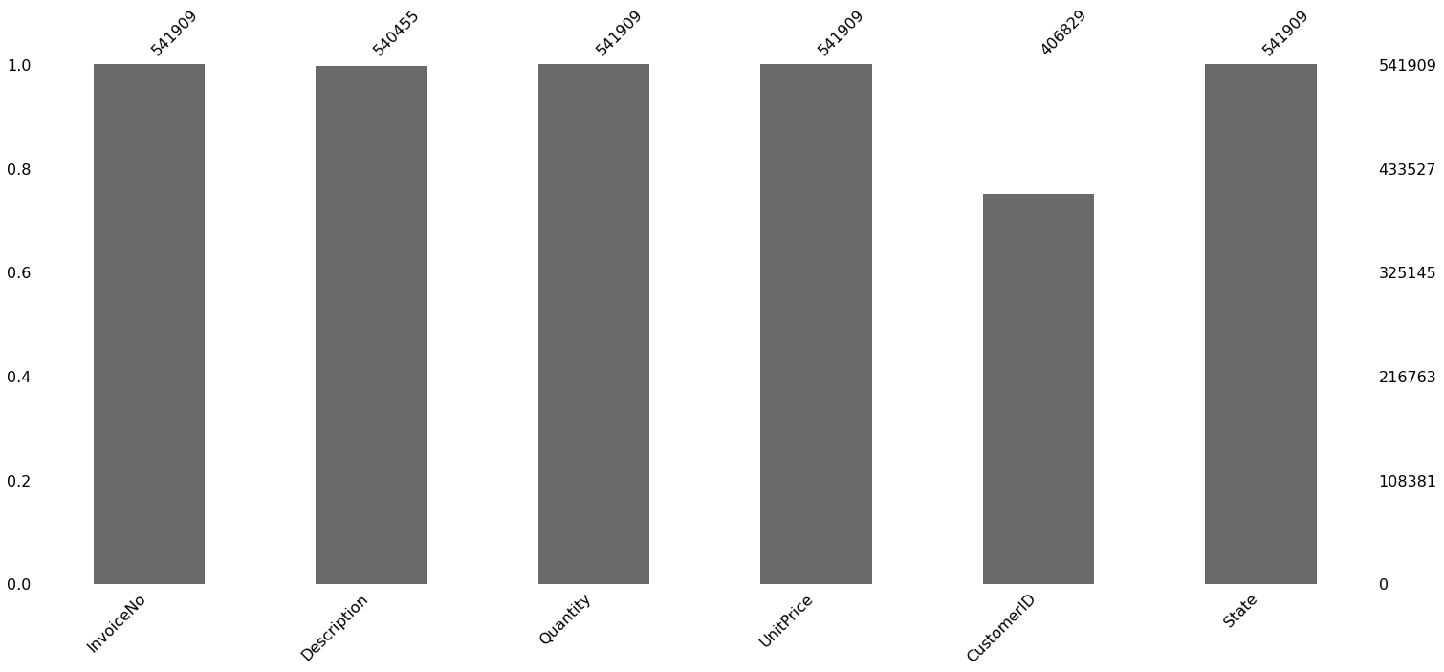
Visualization
Distribution plot of all the features to see if there are any missing values

Slide 10
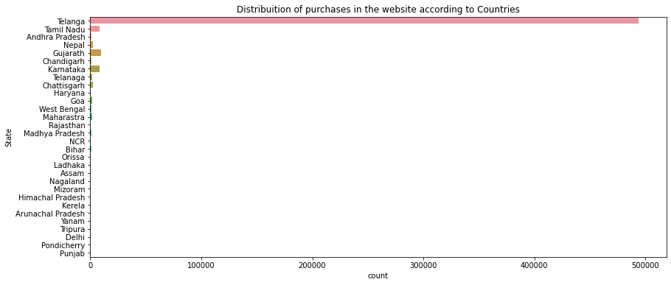
Visualization
Plot to see the distribution of sales across all the states.

Slide 11
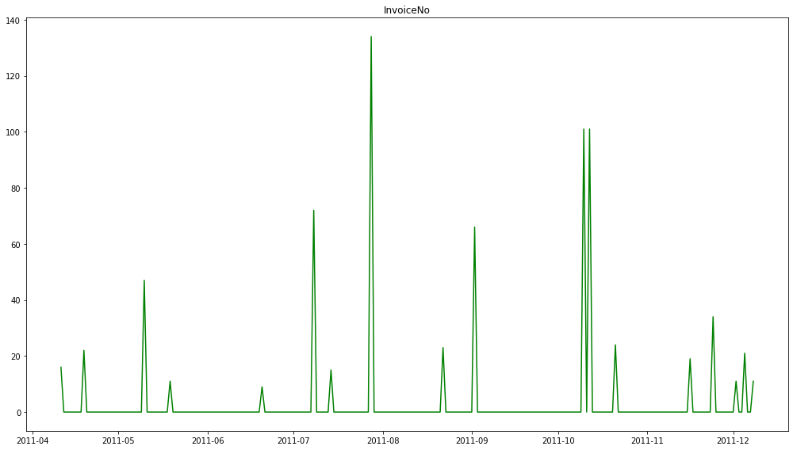
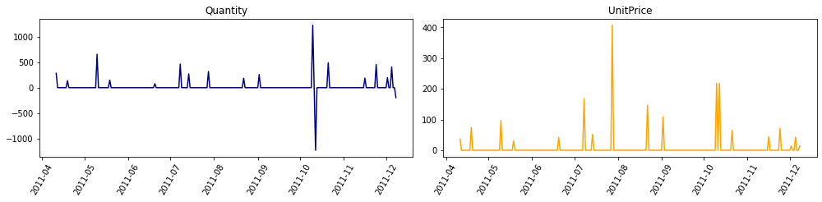
Visualization
Plot to see the distribution of sales across one state

Slide 12
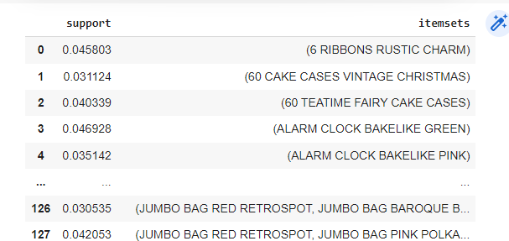
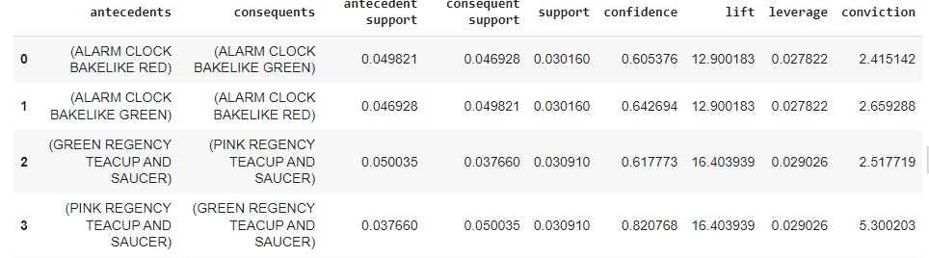
Implementation
By using mlxtend.frequent_patterns implemented the apriori algorthim with minimum support of 0.3 and got the frequently brought items and also the associate rule and also got the confidence levels of the products.

Slide 13
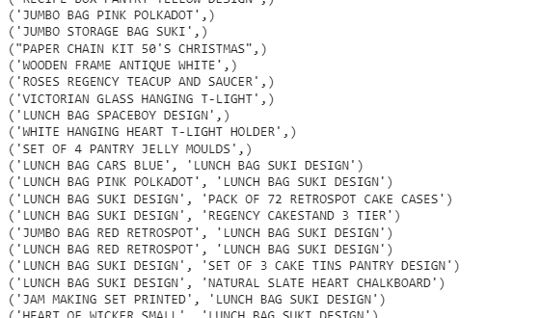
Implementation
Developed the ECLAT algorithm without using any pre-built model built is direct with raw code and got the frequently brought items.

Slide 14
Implementation
Implemented the Fp-Growth algorithm by using the fpgrowth_py with minimum support ratio as 0.2 and minimum confidence as 0 and it resulted as there are no frequent brought products.

Slide 15
Conclusion
The Apriori algorithm or the ECLAT algorithm can be used as the results are significant.
By using the Apriori algorithm the results are very clear. By using ECLAT the support can be varied and can be achieved with the list of frequently brought items.
The Organisation can use the Apriori algorithm for better results in the future.

Slide 16
Thank you!

